Slide 1

The quiz game
DONE BY : (team 12)
K.PRANEETH (1602-20-737-092)
P.KRISHNA SAI (1602-20-737-077)
SK.SOHAIL AKBAR (1602-20-737-106)

Slide 2
ABSTRACT:
The Quiz Application(Game) In Python is written in python programming language, This Simple Quiz On Python Programming is a simple project for testing one’s knowledge power in the given topic examination. The project Quiz In Python contains only the user side. The user must log in or sign up first to start the Quiz On Python. Also, there is a time duration set for solving the questions. The user should solve the questions before time is up.
A Quiz Project In Python just contains the user section. The user can log in to give the exam. After giving the exam, the user can see their score and evaluate themselves. The design of this project Quiz Program In Python Using Tkinter is pretty simple so that the user won’t find any difficulties while working on it.

Slide 3
ACTOR WISE USE CASE(FEATURES)
PLAYER :
LOGIN - REGISTER
ANSWER QUESTIONS
VIEW QUESTIONS
VIEW SCORE CARD
REPLAY OR EXIT

Slide 4
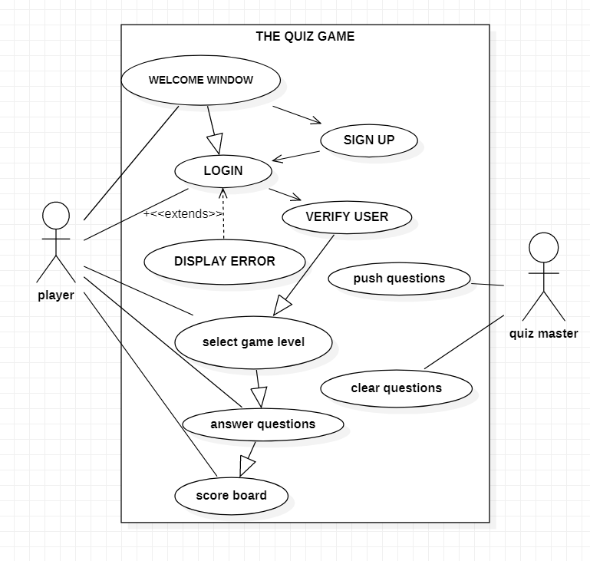

User case diagram:

Slide 5
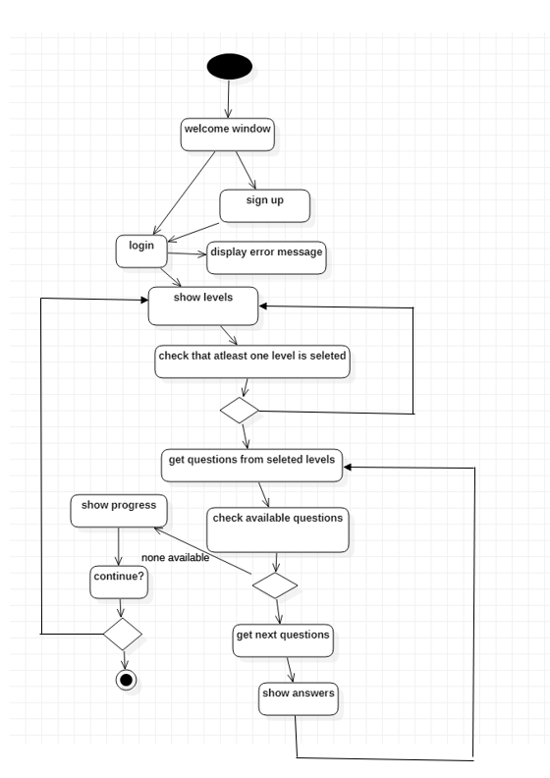


ACTIVITY DIAGRAM:

Slide 6

Technology used
The tkinter package (“Tk interface”) is the standard Python interface to the Tcl/Tk GUI toolkit is used in this quiz game project . Both Tk and tkinter are available on most Unix platforms, including macOS, as well as on Windows systems.

Slide 7
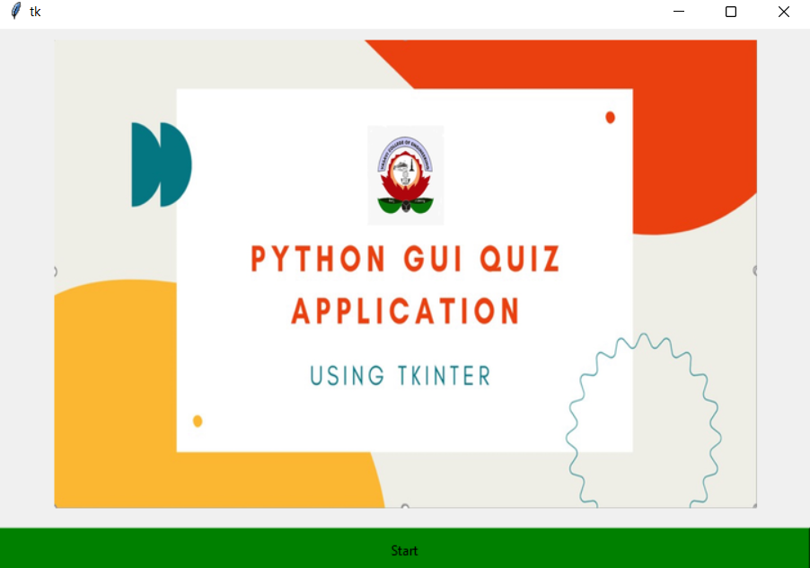
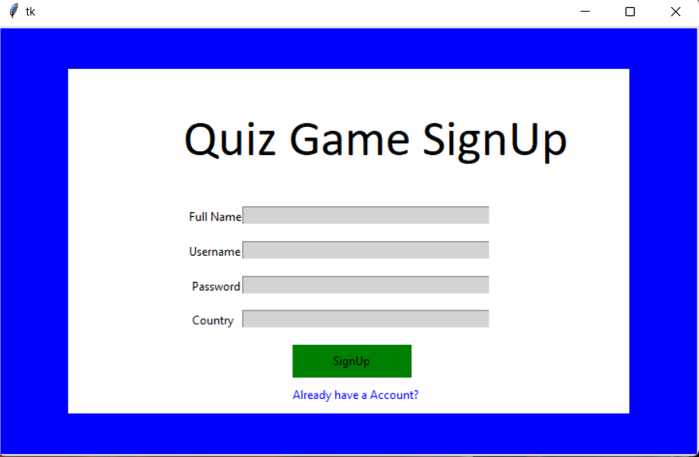
SCREENSHOTS OF EXECUTION

Slide 8
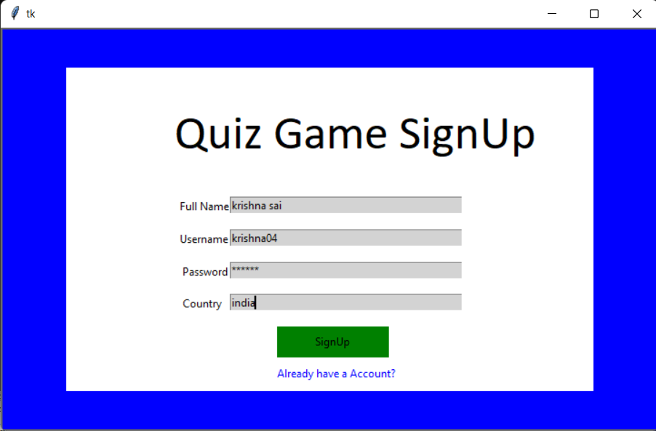
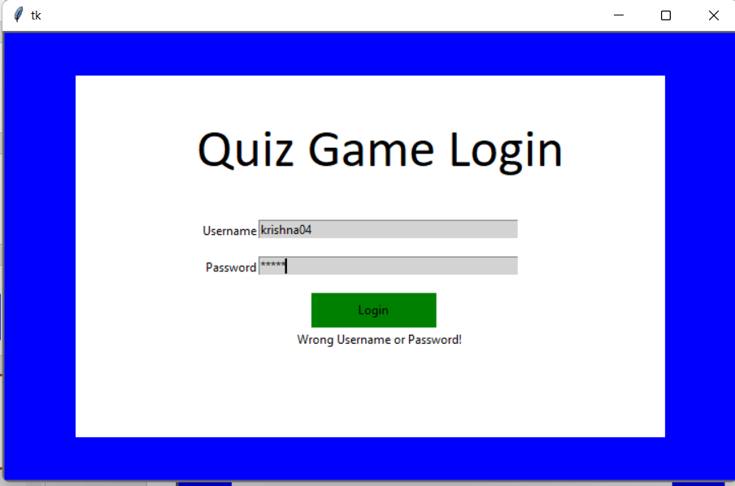

Slide 9
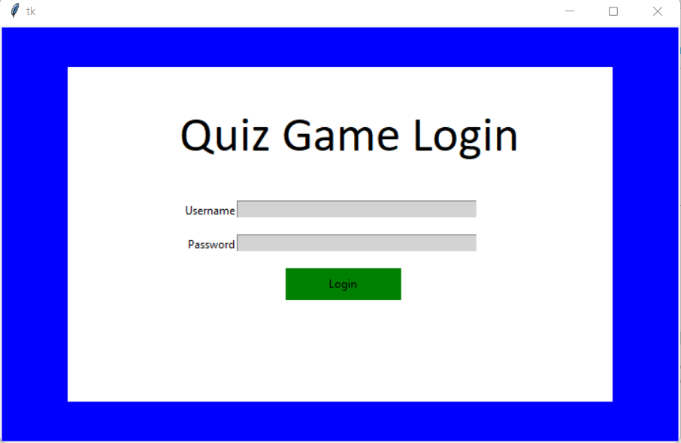
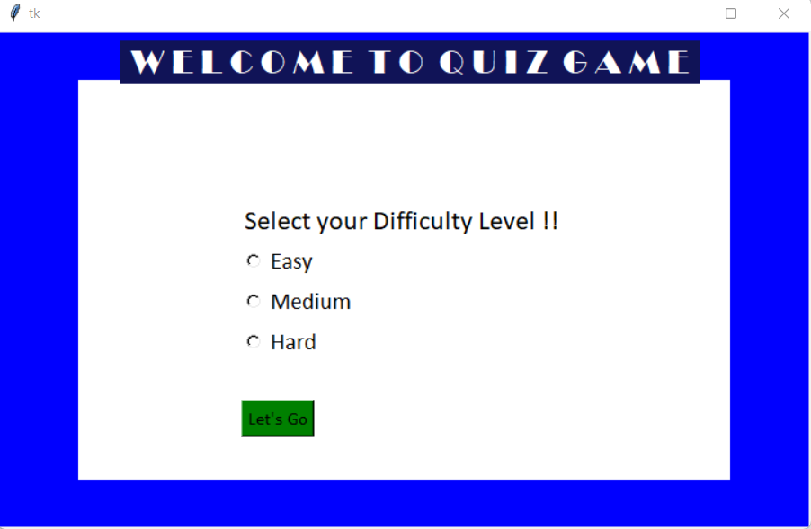

Slide 10
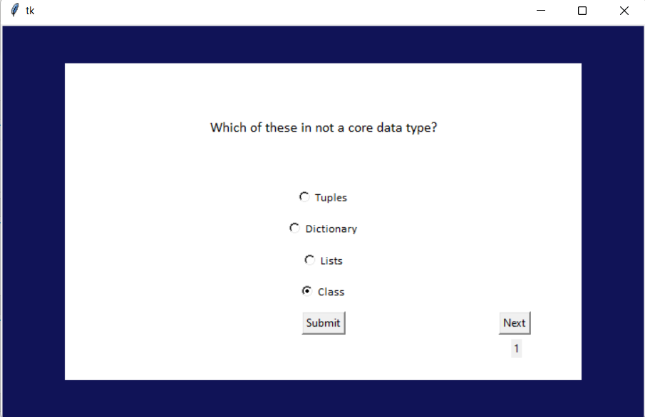
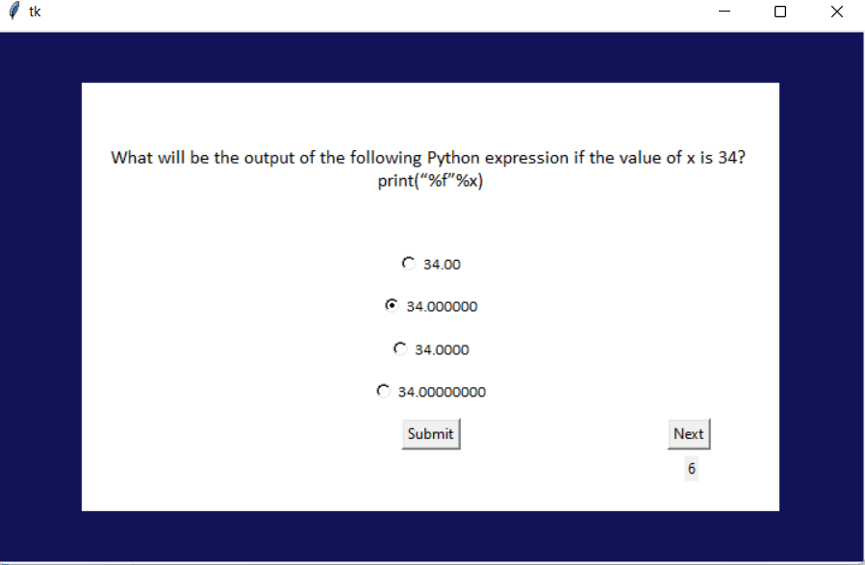

Slide 11
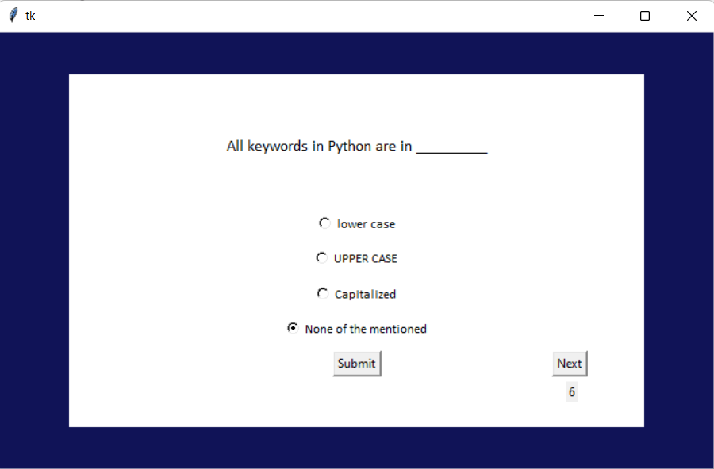
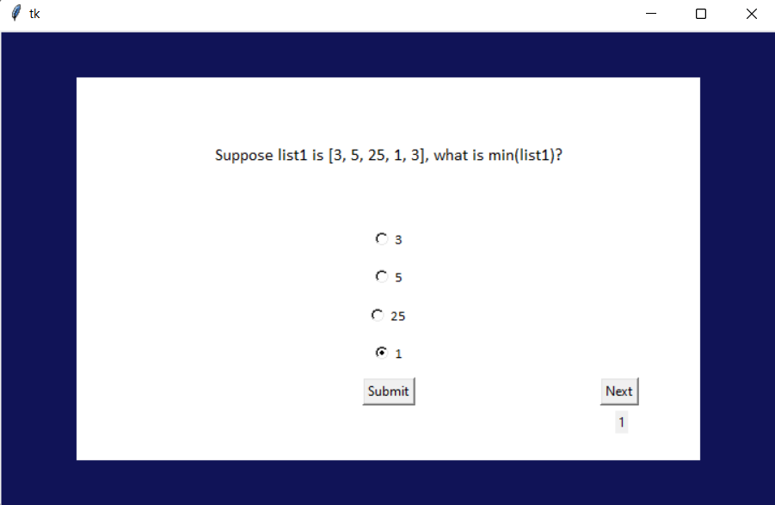

Slide 12
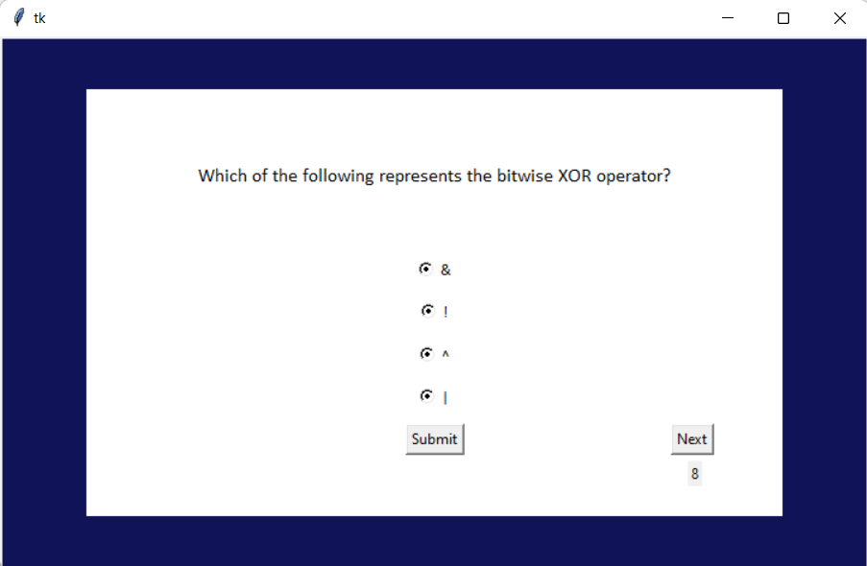
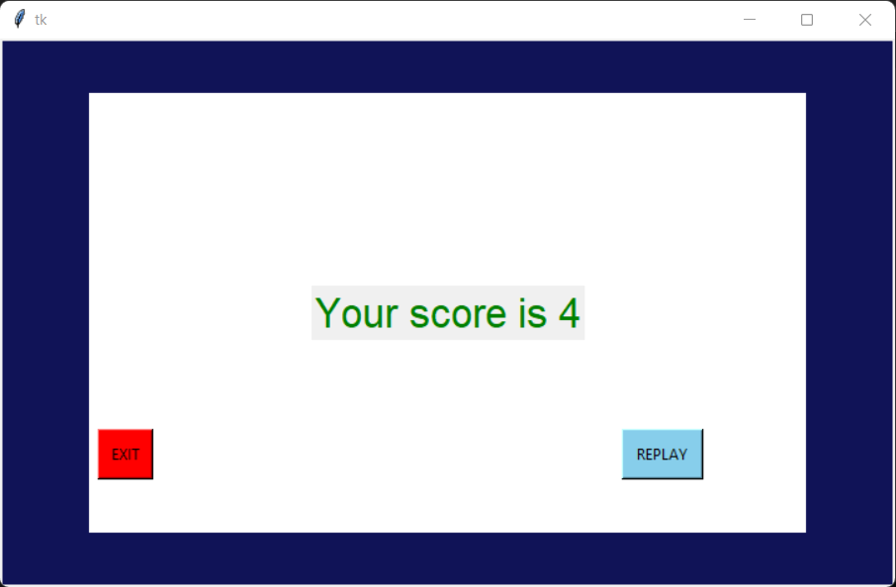

Slide 13
CONCLUSION
The Quiz Application In Python is written in Python programming language, Python is very smooth to research the syntax emphasizes readability and it is able to reduces time ingesting in developing.
Also in this tutorial is the simplest way for the beginners or the student to enhance their logical skills in programming. and also in this game project is the way for the students or beginners in designing and developing games.
The project Quiz In Python contains only the user side. The user must log in or sign up first to start the Quiz On Python. Also, there is a time duration set for solving the questions. The user should solve the questions before time is up.
FUTURE WORK
The Scope of this project is very broad in terms of gaining knowledge and sharing knowledge among world.
In future we can conduct a mega quiz with multiple participants and also we can have entry quiz and we can present gifts to winners . And we can improve more questions and toughness of the game.
And we can provide ebooks for different categories and which are also useful for different competitive exams
In future all exams are going to be online so this game will create a virtual experience to the students .

Slide 14


